Slide 1
Animal life cycle
Mrs.S. Cordero
2-2

Slide 2
Write or paste in your notebook
Today is Tuesday, May , 12, 2020.
Theme: Animal Life Cycle
I. Vocabulary:
1. reproduce= adult animals that have youngs
2. life cycle= changes that happen to an animal during its life

Slide 3
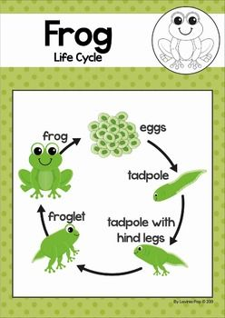
II. Frog life cycle

Slide 4
III. Monarch (butterfly) life cycle Stages

Slide 5
Butterfly Life cycle

